Slide 1

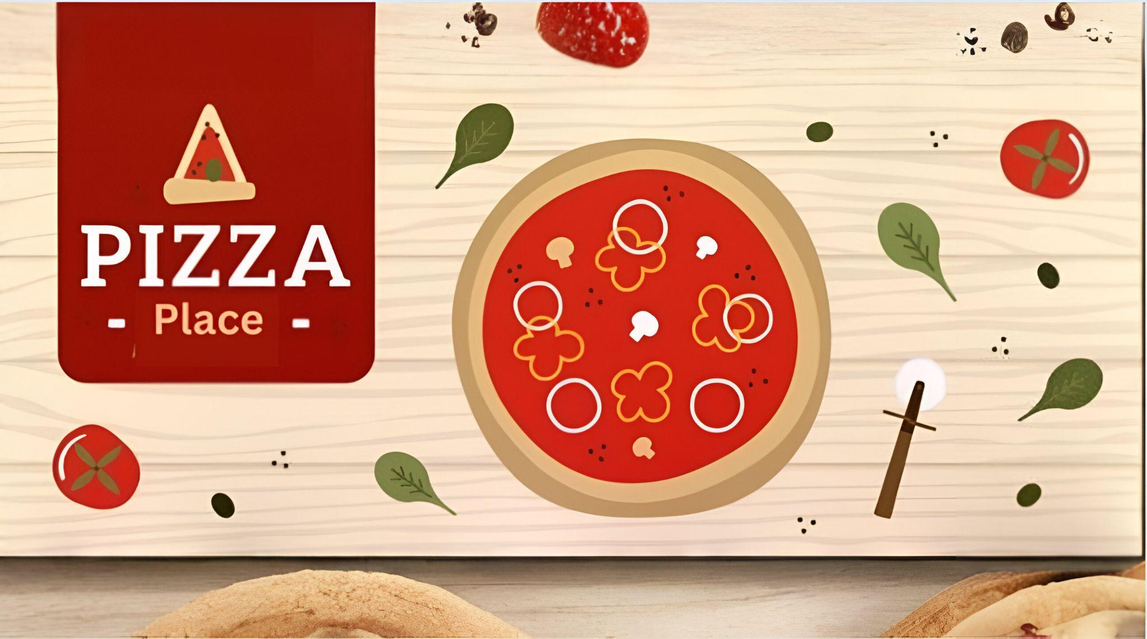

Slide 2
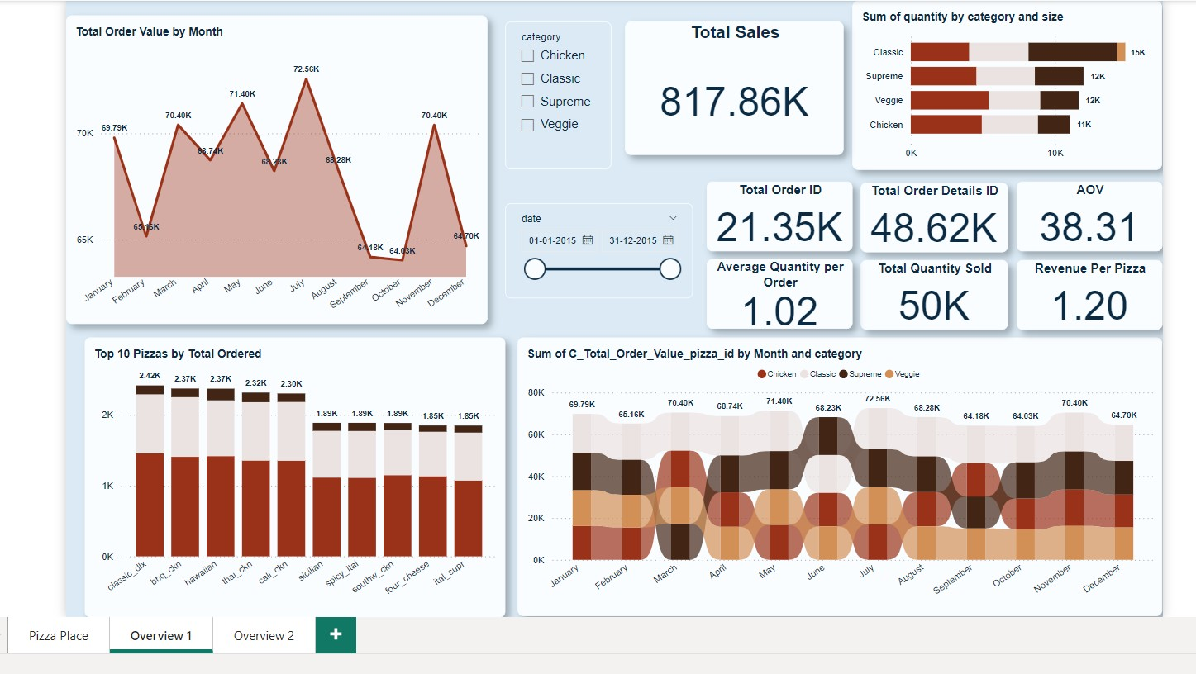

Slide 3
Insight
Sales experience a significant peak from March to July, indicating a strong seasonal demand during these months. However, there is a noticeable decline in sales during September and October.
Classic pizzas dominate overall sales, contributing a significant total of $220K, highlighting their popularity among customers.
The average order value stands at $38.31, with customers typically ordering an average of 1.02 pizzas per order.
Sales are significantly higher in the afternoon and evening, suggesting these are the most lucrative times for customer engagement.
Across all pizza categories, large-sized pizzas contribute more substantially to overall sales.
The dominance of Classic pizzas presents an opportunity to further capitalize on this demand through special deals or bundling offers.
A total of 17,890 classic pizzas were sold, reflecting strong consumer preference for this category.
While classic pizzas generate the highest sales overall, June stands out as an exception where other products may perform better.

Slide 4
Actionable Strategy
Introducing bundling deals or "Buy 2 Get 1 Free" promotions could significantly boost the number of pizzas per order. This strategy encourages customers to purchase more pizzas in a single transaction, which can increase overall revenue while providing added value for customers.
There is a clear need to enhance the variety and appeal of veggie pizzas, as they rank at the bottom in terms of sales from August to December.
Prioritize the top 10 pizzas that contribute the most to sales.
Introduce a reward system where customers earn points for each purchase, which they can later redeem for free or discounted pizzas.

Slide 5
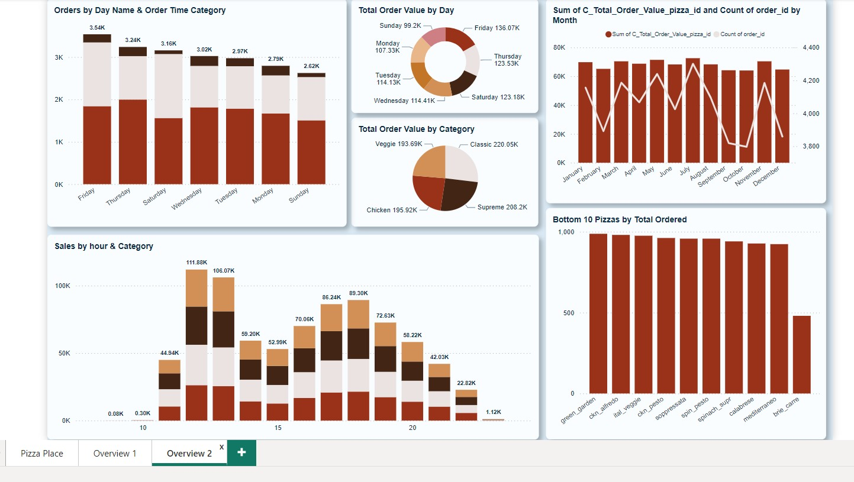

Slide 6
Insight
Friday consistently records the highest number of orders, totaling 3,540, indicating a strong customer preference for pizza on this day. In contrast, Sunday sees the lowest order volume at 2,620
Classic pizzas bring the highest total order value of $220.05K, showcasing their popularity among customers.
The highest sales occur between 12:00 PM to 1:00 PM (lunchtime) and 4:00 PM to 7:00 PM (evening). These time frames are the busiest.
The lowest sales occur before 10:00 AM and after 10:00 PM, reflecting reduced demand during these times.
Customers show a clear preference for Classic and Supreme pizzas, with these categories outperforming others in popularity.
While Classic pizzas lead in sales with $220.05K, Supreme pizzas follow closely with $208.2K, indicating that both categories are strong performers.

Slide 7
Actionable Strategy
With Fridays experiencing the highest number of orders, it's crucial to increase staffing levels and stock inventory adequately to handle the surge efficiently.
Introducing exclusive specials from Thursday to Saturday could attract more customers during these busy days.
Sundays have the lowest order volume, making them an ideal day to promote family-friendly deals and bundles.
Given the popularity of Supreme pizzas, upselling them with other pizza or new menu items can further maximize revenue.

Slide 8

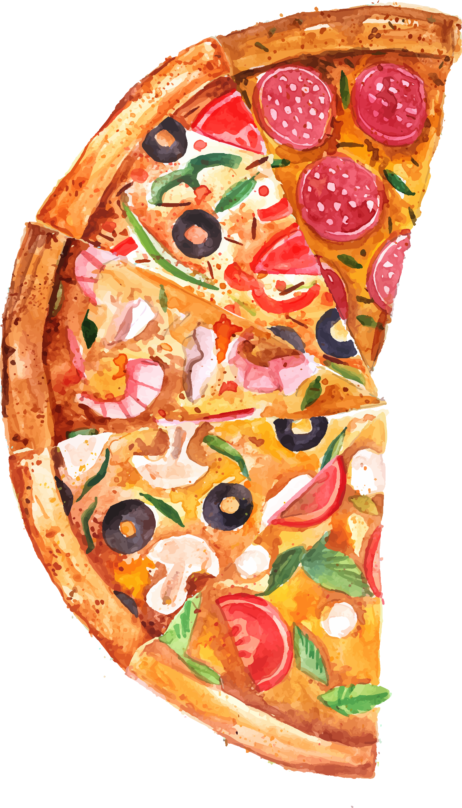
THANKS!
Do you have any questions?
jatinbhavsar000@gmail.com
+91 9924750166

